Slide 1
What’s New in OMS

Slide 2
Overview
Definitions
New OMS features
Ping Dialog
Quality Improvements
New Server Changes
Campaigns

Slide 3
Definitions
IVR: Interactive Voice Response
Calls: Reports of an outage coming into OMS from a variety of sources. One of these sources can be an IVR system.
Callbacks: Calls coming into OMS can be flagged to receive a call back once the outage is restored. FuturaIVR can handle these callbacks for you automatically.
Campaigns Voice or SMS notifications that can be sent to a select group of customers.
SMS: Short Message Service / Text Message
Notes:
Campaigns can also be exported and shared across dispatch teams to follow up with consumers in the event an IVR system is NOT in place.

Slide 4
What’s New in OMS
Bug fixes
Speed and Performance
No longer need Client Java
Fixed Port of 3099 for Sonic Firewall
Fixed an issue with integration where ping requests were unnecessarily sent to AMI
Fixed a close case editing issue where deleting closed case(s) causes the calls to be orphaned
Fixed an issue where OMS could lock up when verifying with CRC
Modified how the alarm audio sound files are played.
Notes:
So on to new Features in OMS.
So throughout the year we’ve come a cross quite a few nasty bugs, many of them thanks to you!! So you should give yourselves a pat on the back for making OMS better. [APPLAUSE?]
these bugs ranging from Major, system crashing, bugs,
OMS IS NOT WORKING (IN ALL CAPS!) bugs
to the occasional alarm not sounding bug. All of which have kept us on our toes to make OMS better.
Oddly enough when we pushed an alarms update recently we've never seen some you guys jump on the update schedule so fast. Its quite evident You all LOVE your alarms!
So whats new.
Satrting with BUG FIXES.
CLICK
So What are some of the bugs we’ve fixed?
CLICK
Fixed an issue in the integration where ping requests were unnecessarily sent to AMI causing ping times to take forever and flood the AMI
CLICK
Fixed a close case editing issue where deleting closed case(s) downstream of a case above a breaker causes the calls to be orphaned This would happen if they were supposed to be picked up by another case above the breaker.
CLICK
Fixed an issue where OMS could lock up when CRC requested a verify and a client refresh was triggered.
And of course we fixed alarms!
Modified how the alarm audio sound files are played. And this was because Some Windows 10 machines would not play the audio.
We’ve also done a FEW UNDER THE HOOD CHANES. We’ve cut out java as a sort of middle man between the client and the server. Meaning we only need to manage java on the server. Some of you guys may remember the days of when an overnight java update would break OMS the next morning.

Slide 5
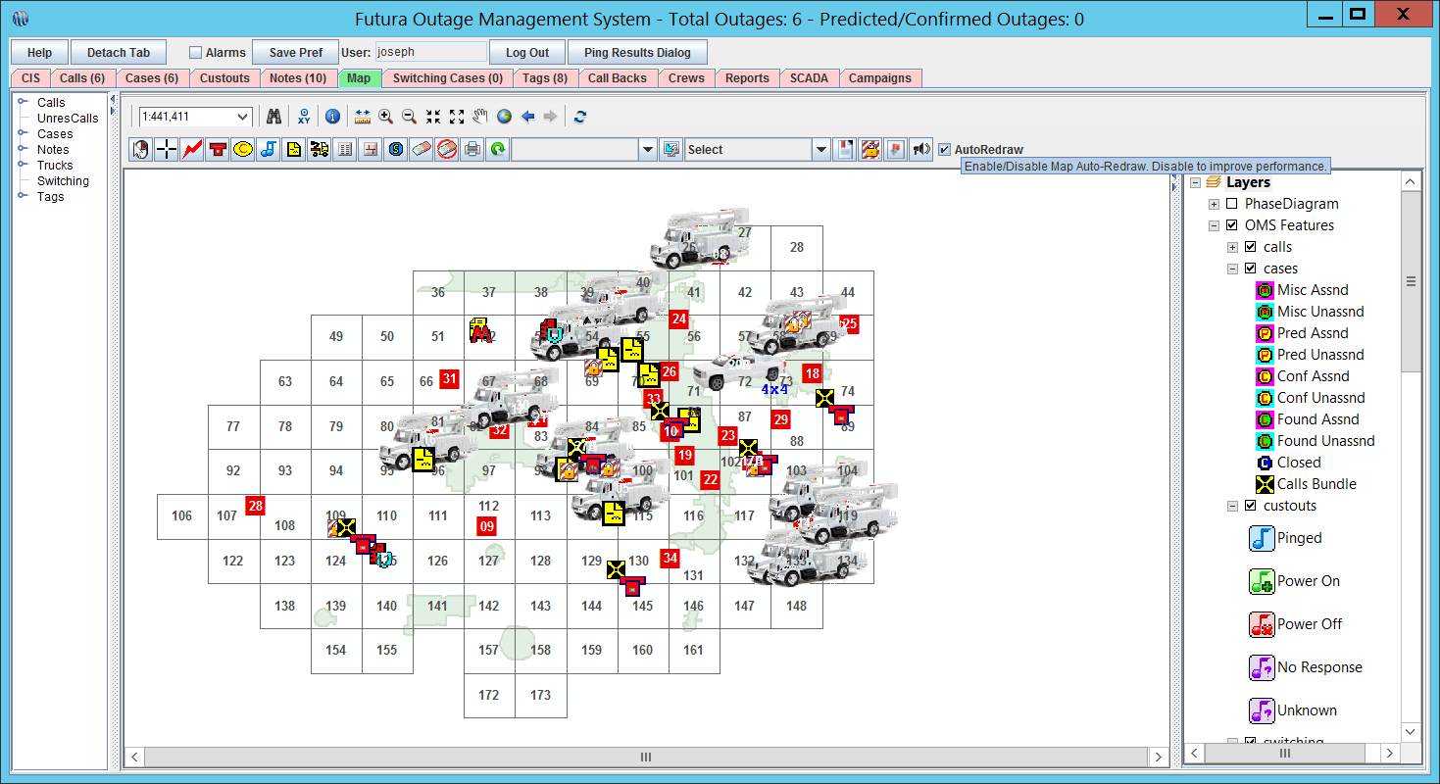
What’s New in OMS
Auto redraw feature added to map tab via a new checkbox.
Right click options to create a call/case, to ping downstream customers, to zoom to an element are available on map tab
New Right Click Menu Items: Create Note, Edit Note, Edit Tag, Edit Truck.
Notes:
As we contrinue to get more into the new stuff we highighlight some of the changes to OMS Client.
CLICK
The auto redraw has been future added within the last year.
This gives the user the ability to disable automatic map redraws which is useful when the system is very busy.
CLICK
You can find this button in your map tab
CLICK
To the far right
CLICK
CLICK
We’ve also made a few adjustments to the Right-Click menu. Now form the right click menu you can ping and trace as well as [CLICK] Create, edit, Delete Notes and tags. We also have truck editing capabilities whenever you right click on a truck.
New Menu for right clicking
Right click from anywhere

Slide 6
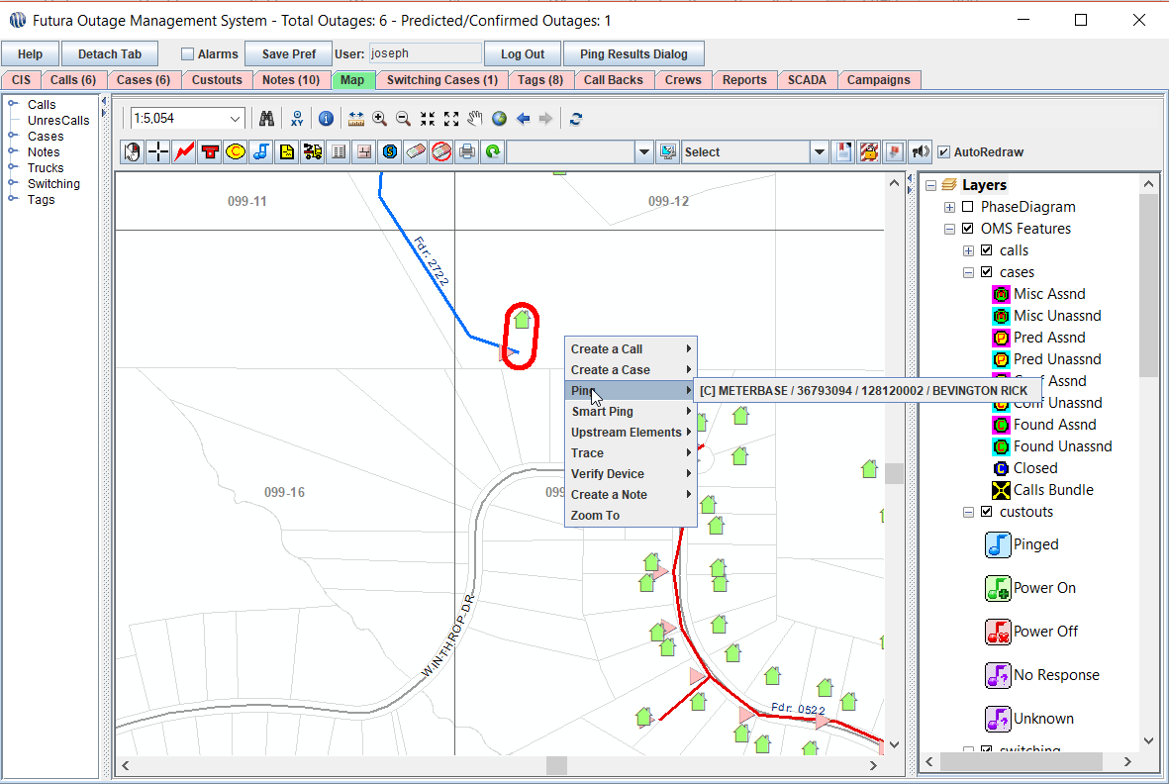
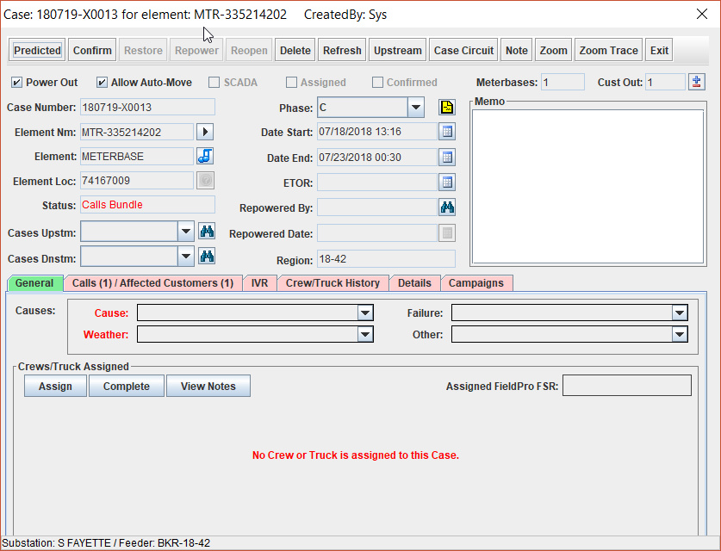
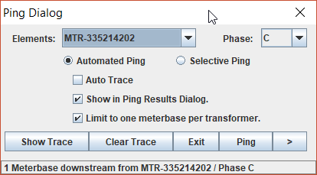
What’s New in OMS(Cont.)
Added functionality to ping downstream customers from the case dialog.
Right click options to create a call/case, to ping downstream customers, to zoom to an element are available on map tab
Ping Dialog and Ping Results
Notes:
[CLICK]
Carrying along with a feature that’s been there for a little while but not many people know about. Withing the last years we’ve asdded the ability to ping directly from the case ticket
Starting with our case dialog
[CLICK]
We can see the Music notes
[CLICK]
And if we click on it we can initiate a ping
[CLICK]
We’ve also made a few minor adjustments to the right-click Menu in OMS
[CLICK]
You can now perform a host of tasks form this menu, including pinging, verifying, and tracing. Its been expanded from when we first launched “Right-click” functionality last year. Make sure you guys check it out the next time you use the “Right-Click”
Also: Little known fact but you can access right click options by using any tool on the futuraoms toolbar
[CLICK]
Another one of the changes I wanted to highlight has to do with pinging and ping results.

Slide 7
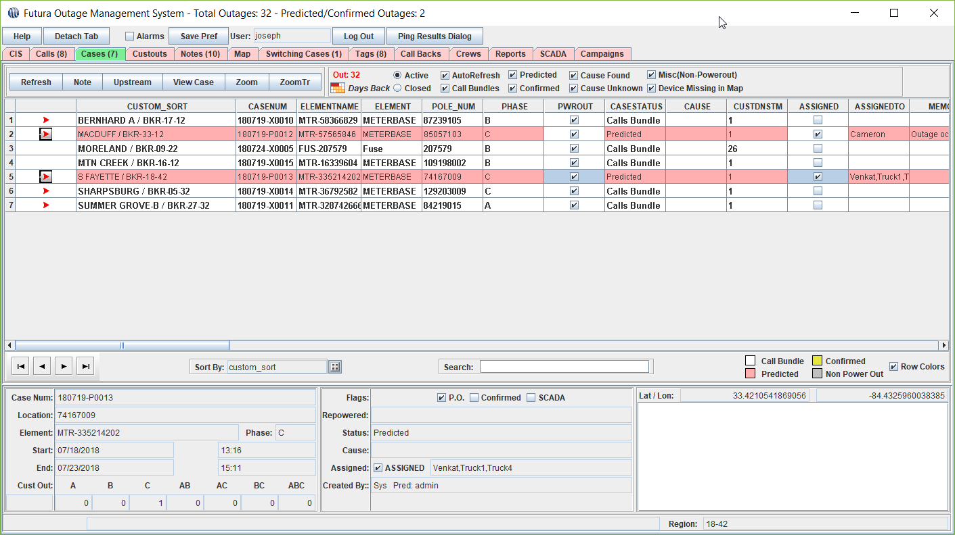
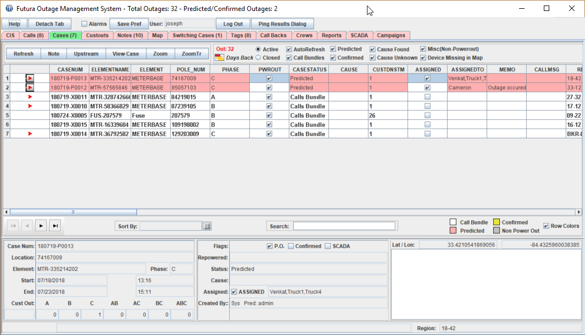
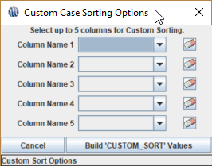
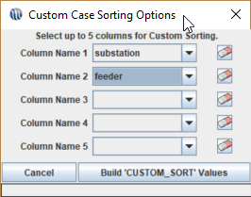
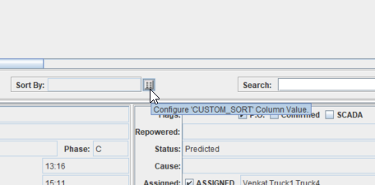
OMS Custom Sort
Notes:
So remember how we said we’ve taken a lot of input from you guys our clients on how we can make the product better? Well, One of your guys’ AWESOME suggestions has been the ability to custom sort the fields in our grids.
Thanks to you guys we now have this option. So give yourselves a pat on the pack for making OMS better!
So here we see just a normal grid
CLICK
At the bottom Middle there, we see a new button
CLICK
We’ve added the option to dictate how you want the grid to be organized
CLICK
So now I can organize my cases based on anything I want. In this example, I want the sub and feeder.
CLICK
Now that we’ve selected what fields we want to sort… we then select Build
CLICK
And then we see our new custom sort!

Slide 8
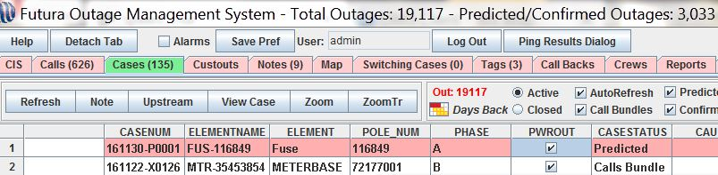
Ping Dialog
Notes:
You can access the Ping Results Dialog historically for as long as your login session is running. Once you close out of OMS client or you log out the history will be cleared out. That’s a lot to say and hard to follow, so let me clarify a little here: as long as you are logged in as a client user the entire history of ping results will be available to you for that session. From any tab view within OMS you have access to the Ping Results Dialog button.

Slide 9
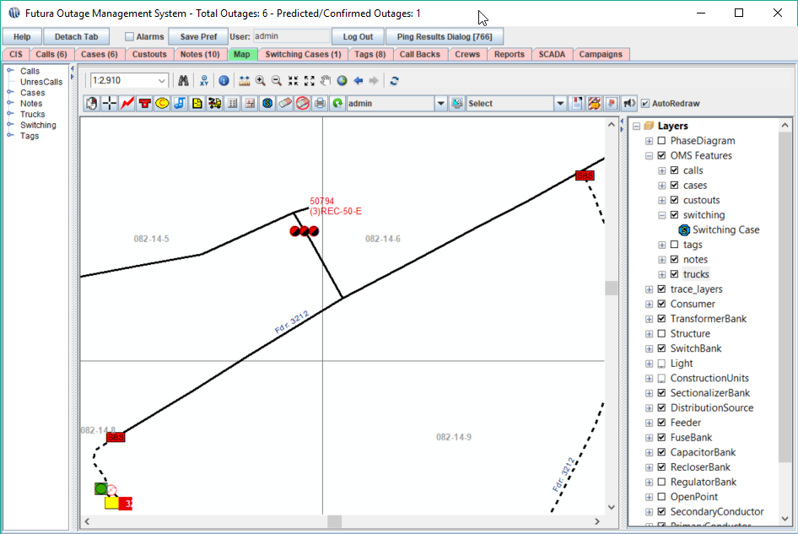
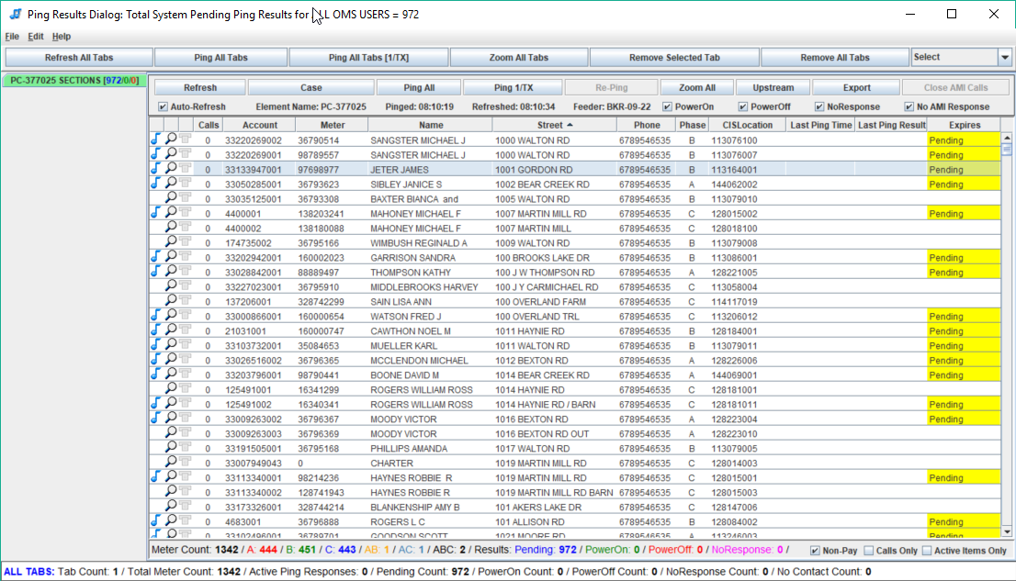
Ping Dialog
Notes:
So here's your new and improved Ping Interface (CLICK)
So by now you all are quite familiar with this interface. Its used for pinging and reviewing historical ping responses.
[CLICK]
Some changes you might not have noticed is a running tally/counter of the pending PING responses.
CLICK
You can find it in the dialog itself or…
CLICK
In the OMS window
CLICK
Right here at the top
CLICK

Slide 10
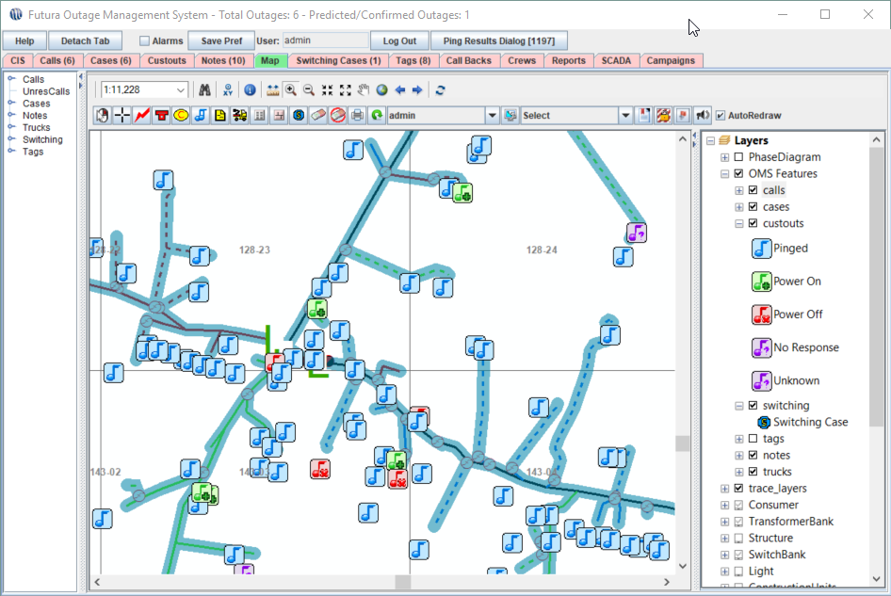
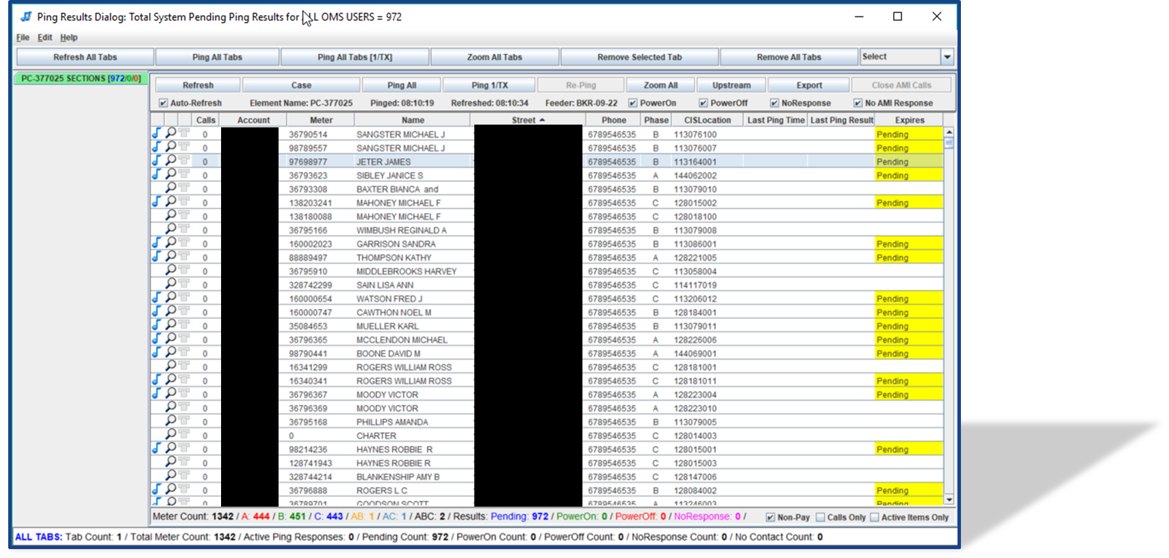
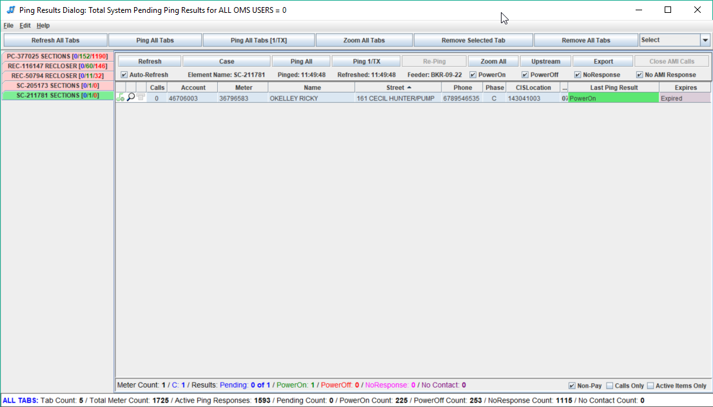
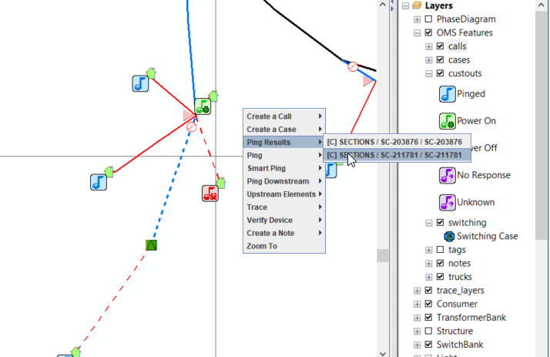
Ping Dialog
Notes:
So while were on the topic of pinging, we know how critical meter responses are to your operations especially when in a heavy storm situation.
Being able to get those responses back and have that information readily available can help you better identify the problem AND Help get dispatch personnel
For this reason we want to bring ping results to you as quickly as possible as well as in as many places as possible. As you’ve seen, we already have the PING DIALOG
CLICK
But we also have access to this information in various places
Fist and probably the most visible, is in the Map view of OMS.
CLICK
Here we see a bird's eye view of the ping responses and as you can see the color coded responses
Now if we zoom in a bit closer we can use our right-click to pull ping results as awell
CLICK
And BOOM
CLICK
The record of the last ping shows up in the dialog

Slide 11
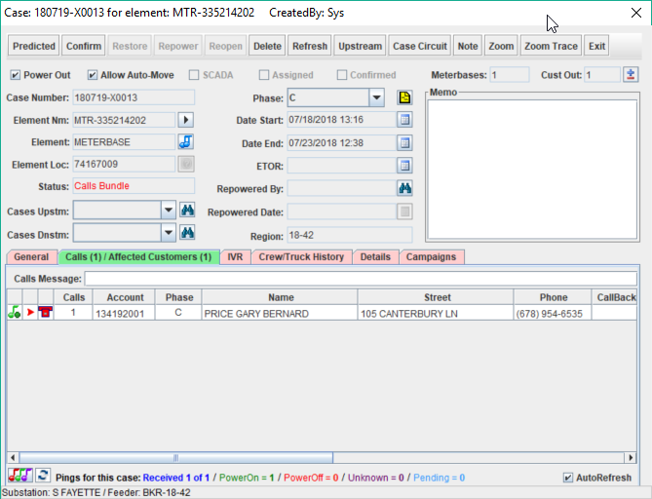
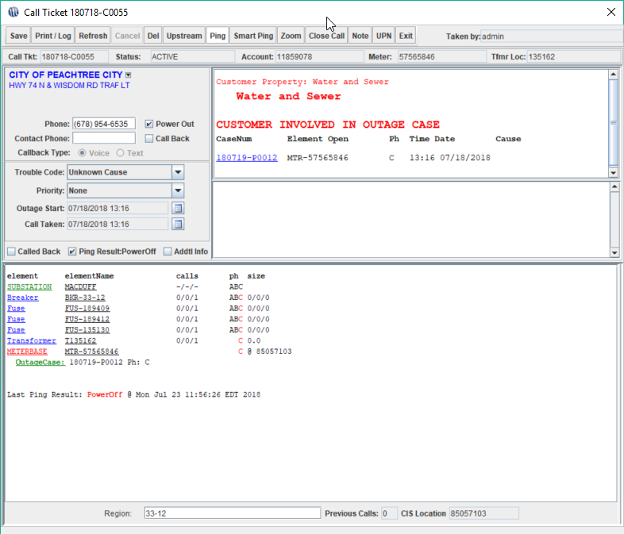
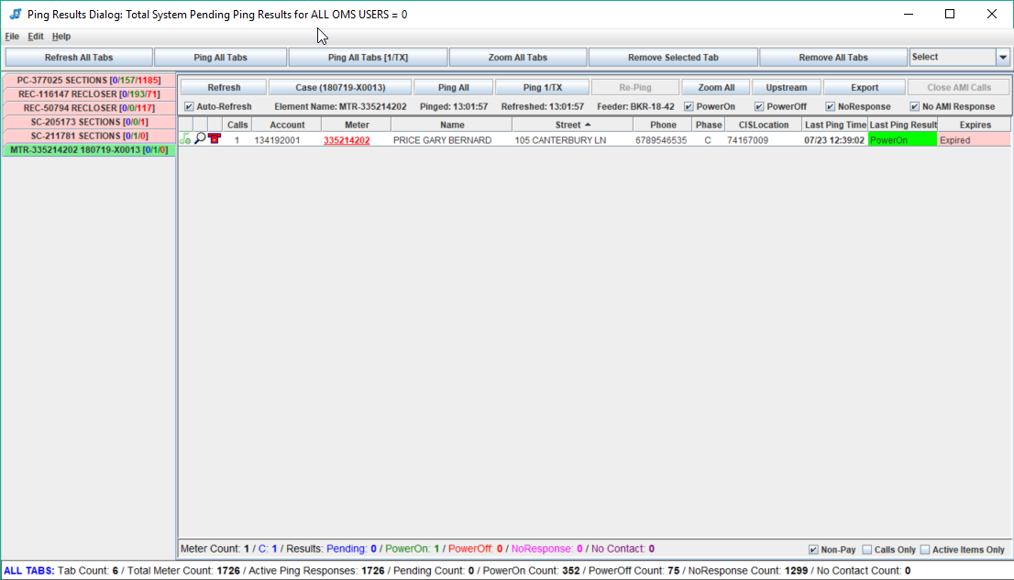
Ping Results
Notes:
While we’re still on the topic of pinging, I wanted to show you some other places where the ping results permeate throughout the software.
One such place is in the call ticket window
CLICK
At the bottom of the window we see the last ping and it even had a “POWER OFF” response.
CLICK
Now lets look at the Case dialog.
CLICK
More specifically the “Calls/Affected Customers” tab
CLICK
From this menu we can see the last ping result
CLICK
We’ve also added a button to pull up the specific ping results for this specific case.
CLICK
At the bottom right we see our musical notes and if we CLICK that, we will again be taken to the ping results window
CLICK

Slide 12
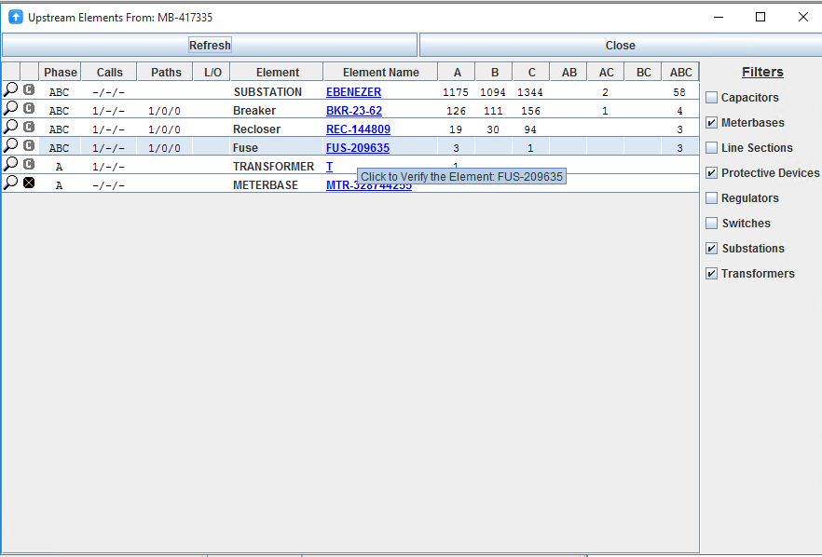
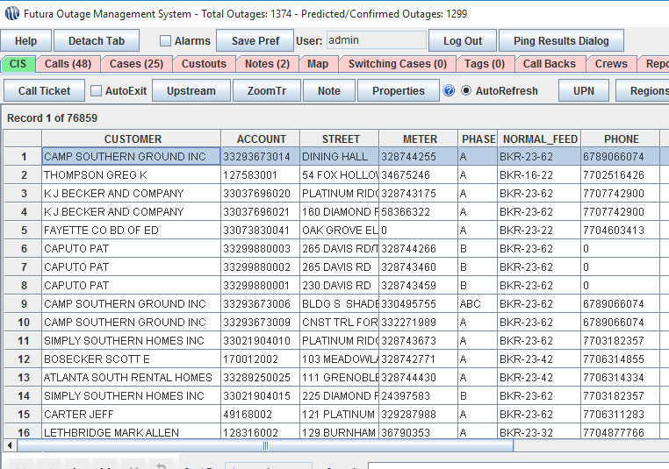
Upstream/Verify
Notes:
Next up, we have another new interface.
If you’ve ever opened up a call or case you know that we have a breakdown of the devices in the circuit.
Now we offer a new clean interface to illustrate the path of the circuit all the way back up to the source. By clicking on a customer, call, or case and then clicking the “Upstream” button CLICK (Animation) you will be greeted with this menu CLICK (Animation)

Slide 13
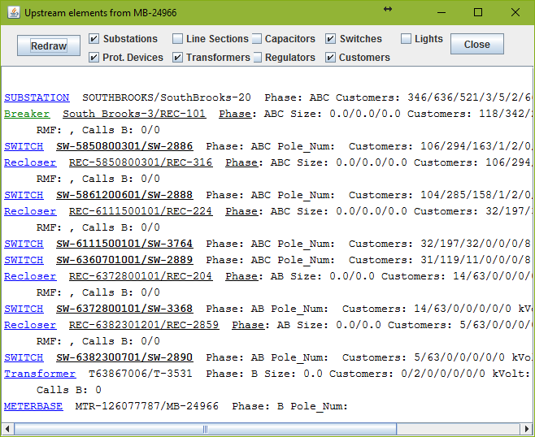
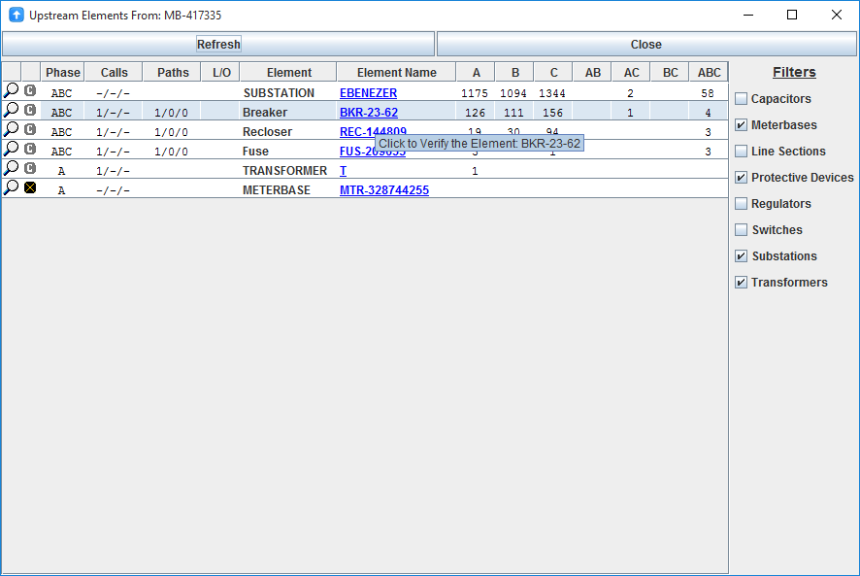
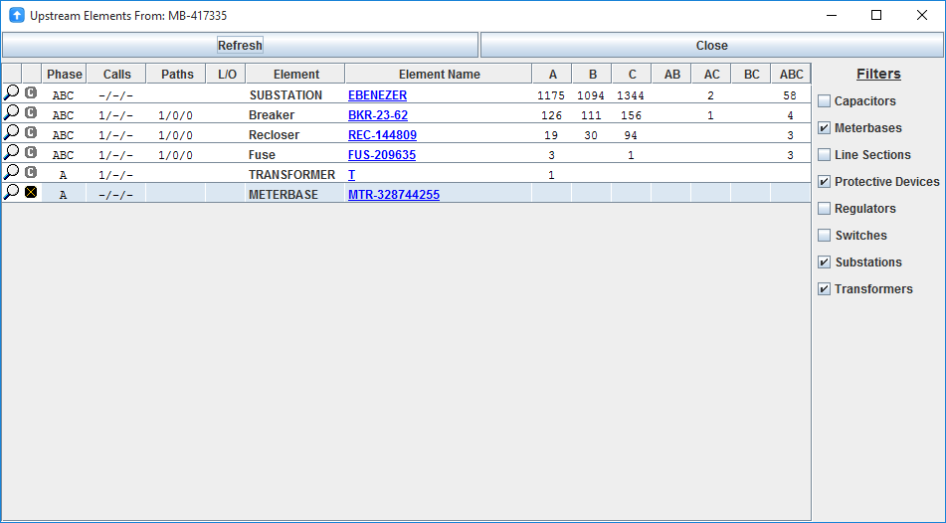
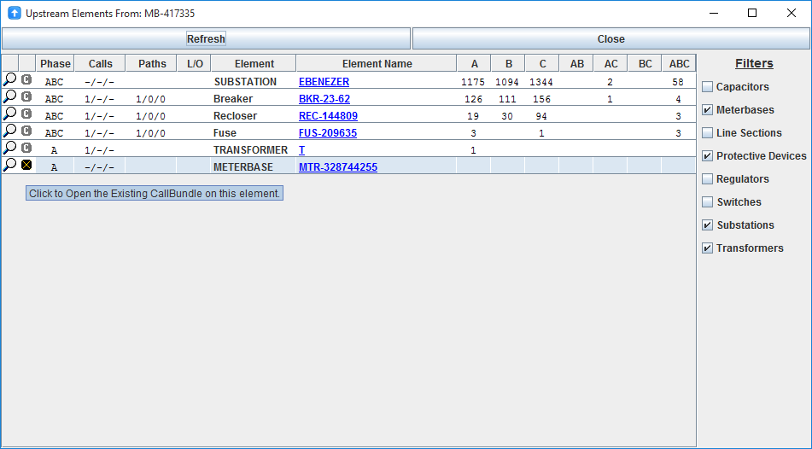
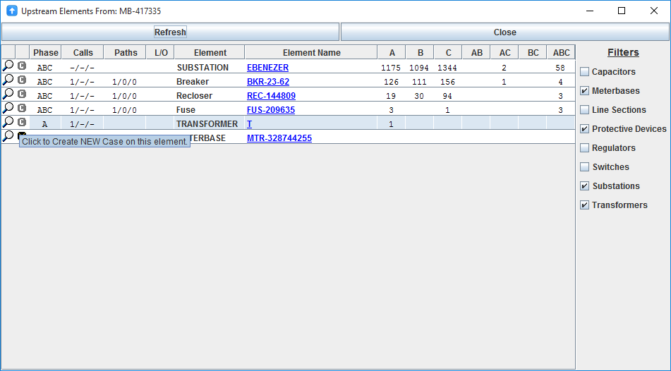
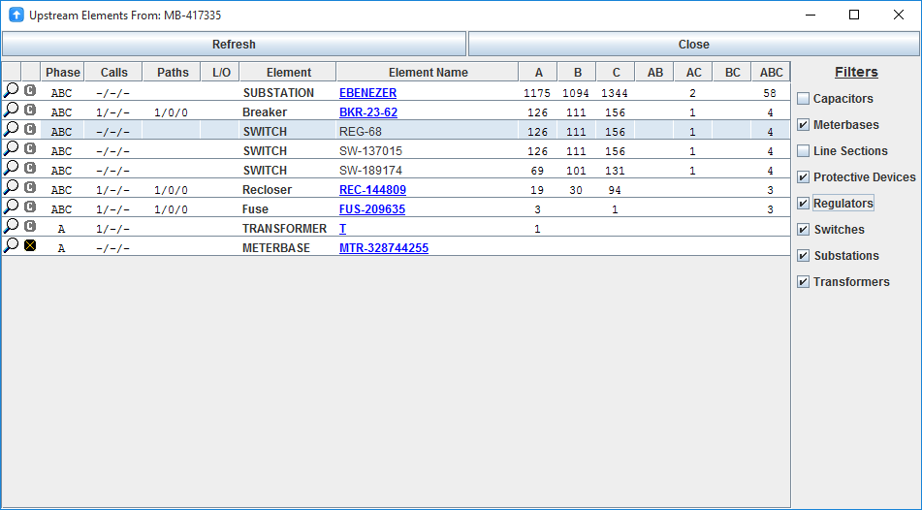
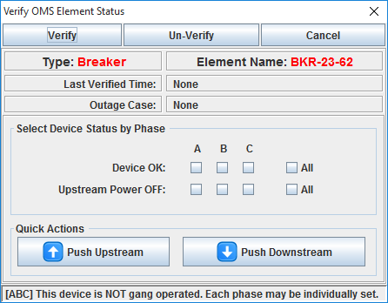
Notes:
I wanted to cover some new interface changes that often times get overlooked by all of the other major changes.
So here we are. Now to show you where we’ve come from. OLD (CLICK- animation) Upstream dialog vs. NEW (CLICK – animation)
Now isn’t that just a whole lot nicer!!
Its all nice and shiny and has buttons
Something else to note are the annotations that highlight what each button does.
(CLICK – animation)
If you hover over the ‘X’ you can see it’s in a call bundle
(CLICK – animation)
Hovering over a ‘C’ you can create a NEW case on the upstream element.
(CLICK – animation)
If you look to the right side of the dialog we can see you have options to turn on and off certain elements in the circuit.
(CLICK – animation)
Here we can see Regulators and switch elements have been toggled on.
Also, a feature that may go a little under the radar is the fact that you can now verify up or downstream with fewer steps.
(CLICK – animation)
You can verify when you hover over the element and click for the new menu to appear.
(CLICK – animation)
So lets take a look at this menu
(CLICK – animation)
From here, we see we can move the outage depending on what element is out and we can even select the proper phase.
And upon verification of the element the case will then be moved to the proper device that is out. Easy as 1,2,3 and the interface looks a whole lot nicer. It’s one of those updates improve upon both the form and functionality of the software.

Slide 14
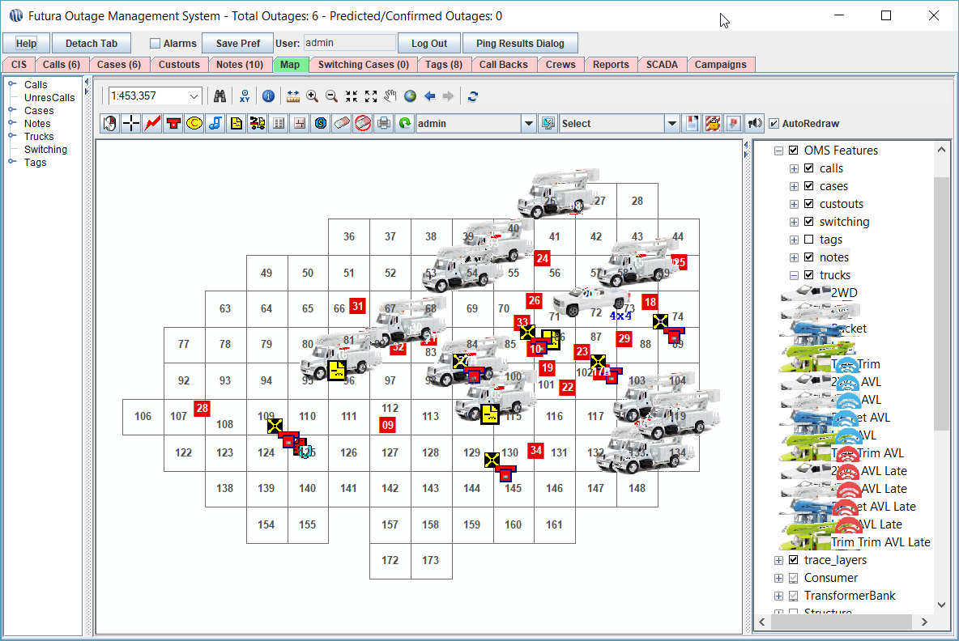
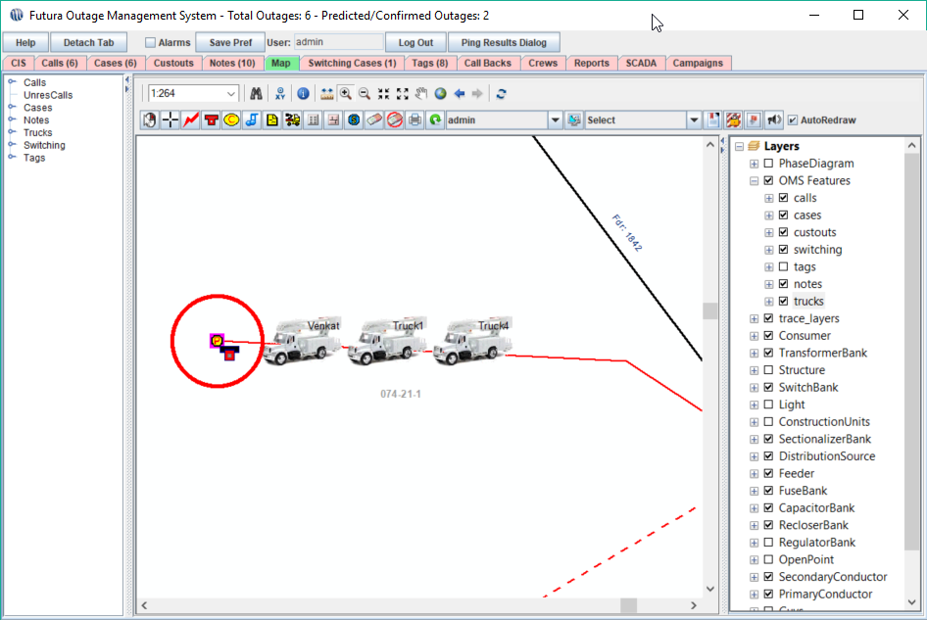
Trucks
Notes:
Now Moving on to Trucks!!!
We’ve got new truck icons!
CLICK!
We’ve recently decided to update our icons to better reflect the type of truck we see in the field. It’s a more cosmetic change but the icons look great!
We’ve also made it so that the icons appear a little more organized as we zoom in to sites with multiple crews.
CLICK
We see here that the trucks are not stacked on top of each other but labeled with the name , side-to-side. Just as a note, we also have the ability to display the trucks vertically aligned as well.

Slide 15
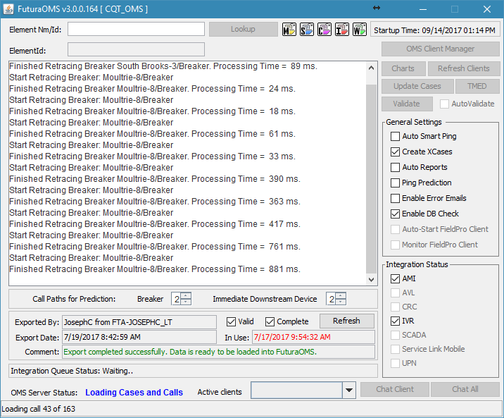
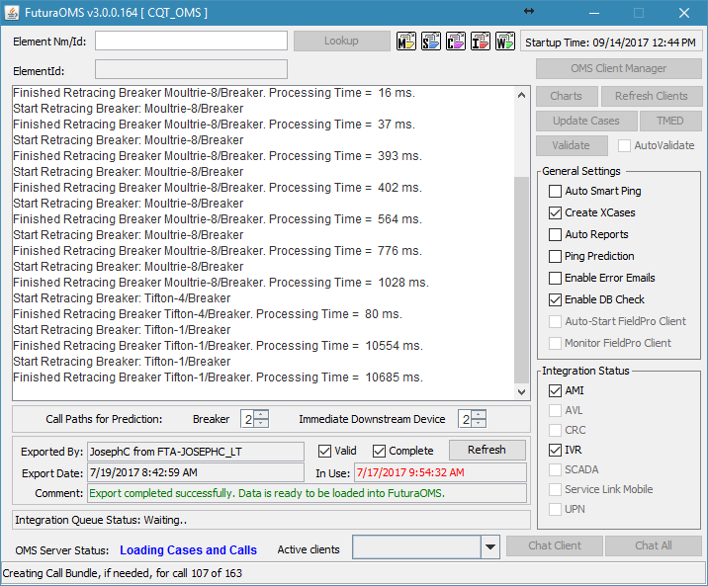
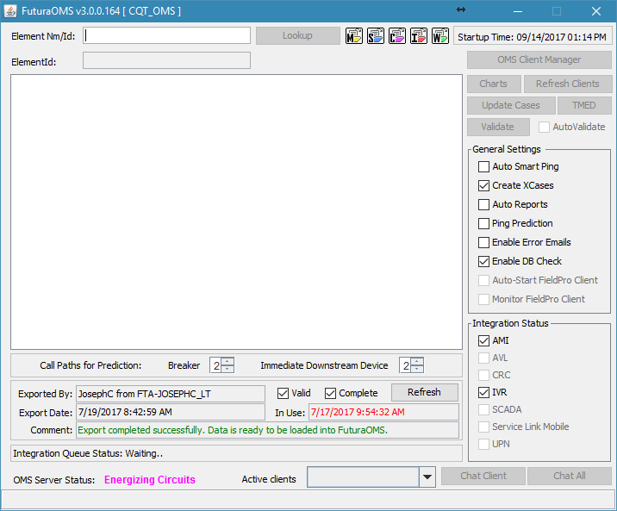
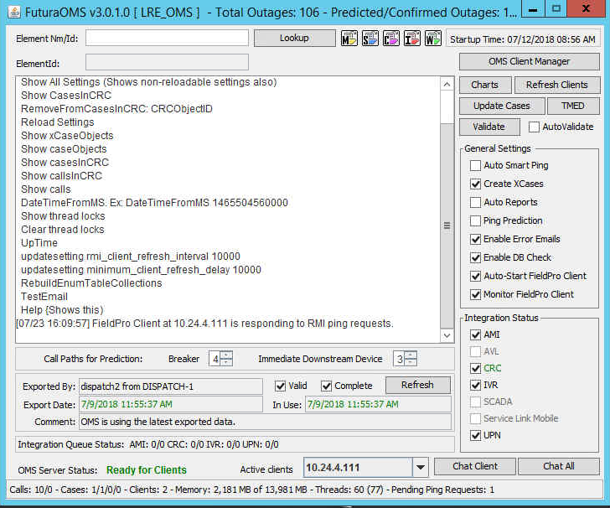
Server Changes
Notes:
SERVER Changes
We’ve also made a great deal of improvements to the server application as well. Most of which are under the hood.
Of course we’ve made the usual bug fixes and speed improvements, especially with those clients on ESRI 10.4 and higher.
ProTip: If you are NOT yet on ESRI 10.4 please see one of us about getting on the upgrade schedule, just note that you will have to upgrade ESRI for GIS and OMS.
So some of the more visible changes that you may have already witnessed come in the form of status messages!
CLICK
Here we see the status of our integration Qs as well as
CLICK
Another quality of life improvement is When OMS is starting up and loading calls and cases. We keep count as we process this information.
CLICK
Same goes for Loading of cases. There’s A running count as they are being built into the system
Another change is that we’ve made it easier to implement changes WITHOUT having to restart OMS in its entirety.
CLICK
From this menu we have the option to edit Some of these settings on the fly!

Slide 16
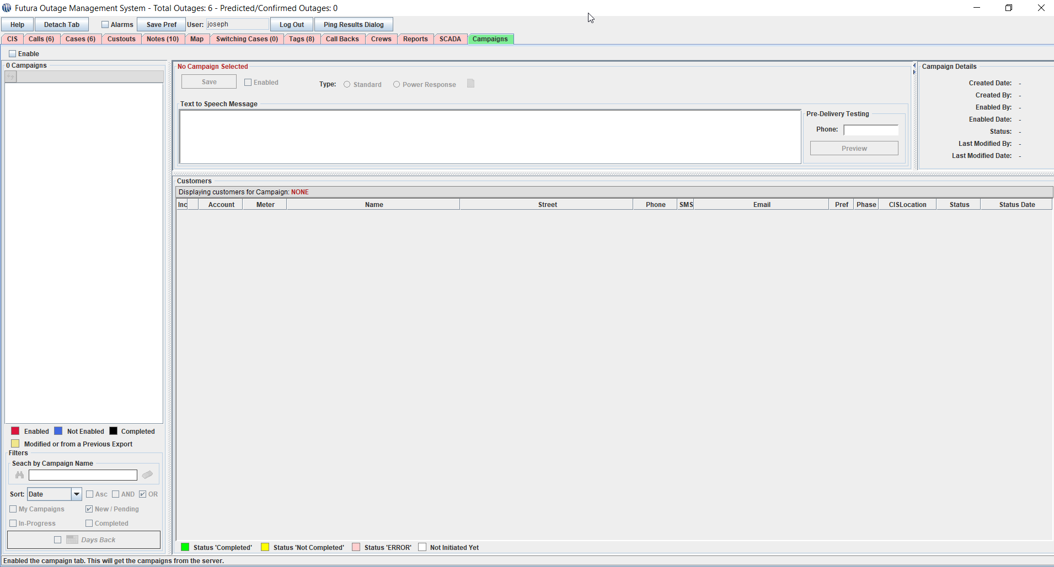
Campaigns
Notes:
Now I want to show you all the campaigns tab in OMS
This is one of our newest features that can be used to create a list of callback responses and have the software automatically reach out to those consumers. The automatic functionality highly depends on your IV vendor if they support this feature.
Campaigns can also be exported and shared across dispatch teams to follow up with consumers in the event an IVR system is NOT in place.

Slide 17
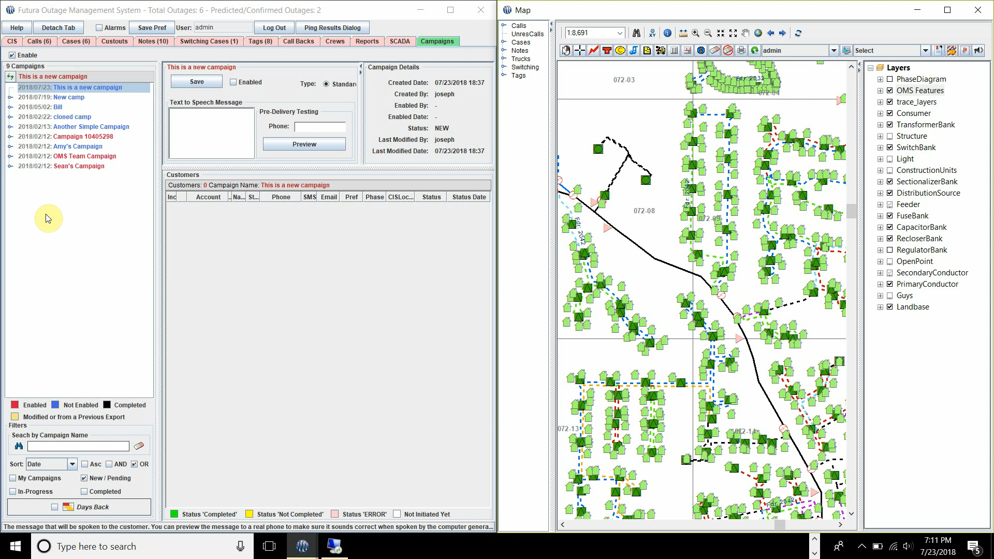
Campaigns – Viewing
Notes:
Now I want to show you all the campaigns tab in OMS
This is one of our newest features that can be used to create a list of callback responses and have the software automatically reach out to those consumers. The automatic functionality highly depends on your IV vendor if they support this feature.
Campaigns can also be exported and shared across dispatch teams to follow up with consumers in the event an IVR system is NOT in place.

Slide 18
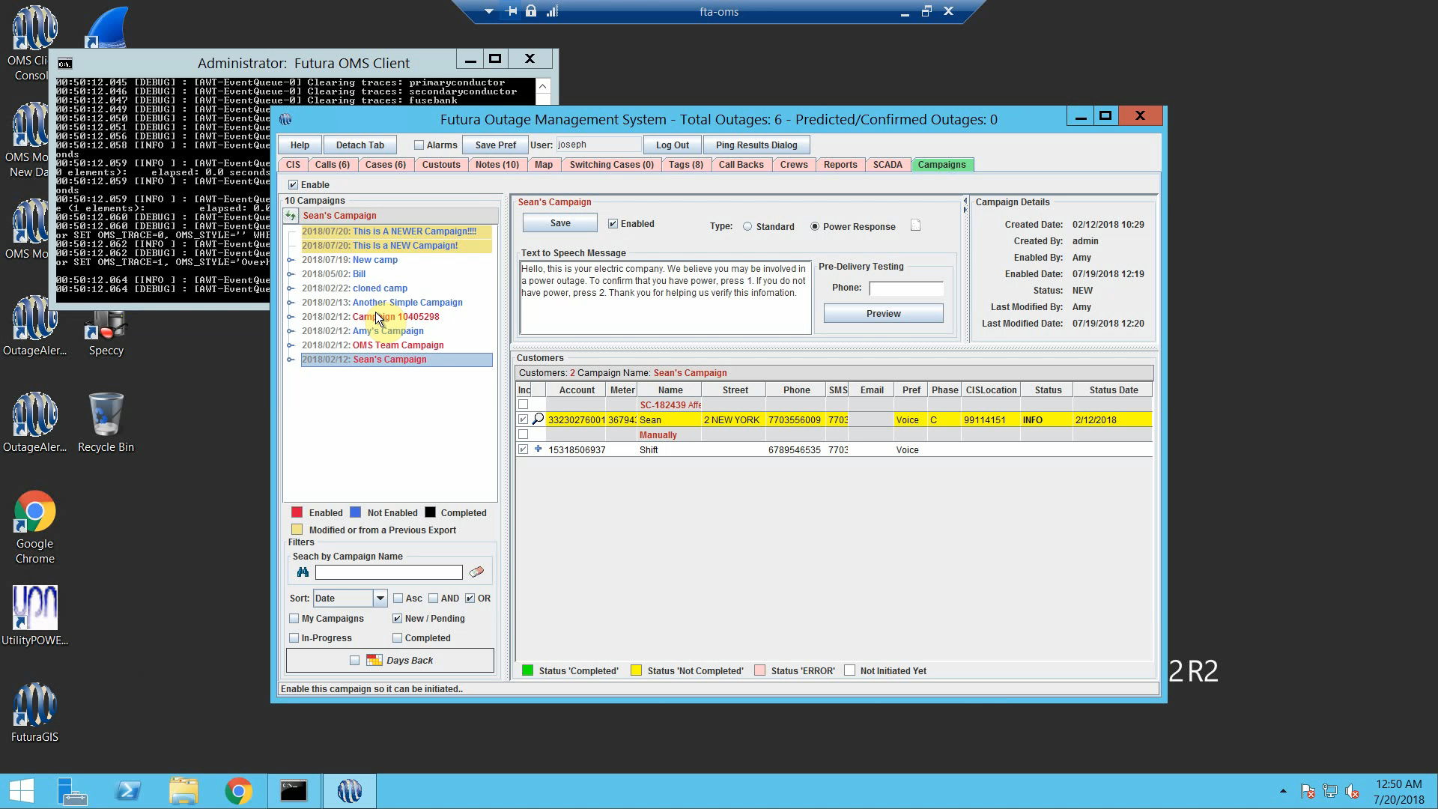
Campaigns – Create/Delete
Notes:
Now I want to show you all the campaigns tab in OMS
This is one of our newest features that can be used to create a list of callback responses and have the software automatically reach out to those consumers. The automatic functionality highly depends on your IV vendor if they support this feature.
Campaigns can also be exported and shared across dispatch teams to follow up with consumers in the event an IVR system is NOT in place.

Slide 19
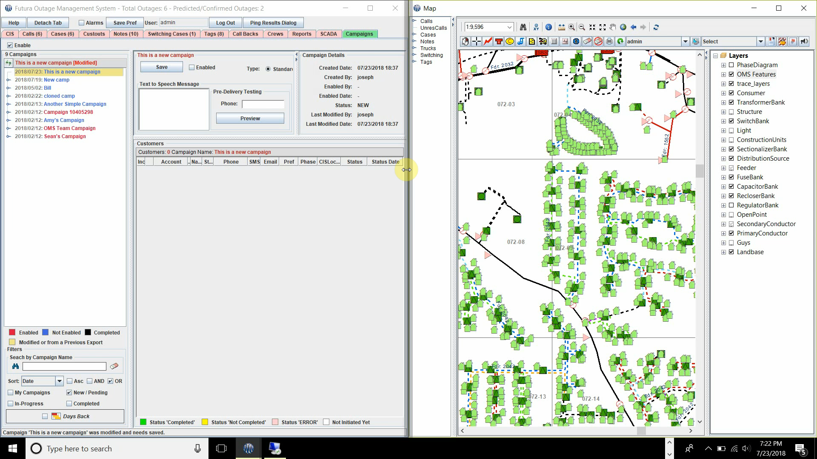
Campaigns – Campaign Builder
Notes:
Now I want to show you all the campaigns tab in OMS
This is one of our newest features that can be used to create a list of callback responses and have the software automatically reach out to those consumers. The automatic functionality highly depends on your IV vendor if they support this feature.
Campaigns can also be exported and shared across dispatch teams to follow up with consumers in the event an IVR system is NOT in place.

Slide 20
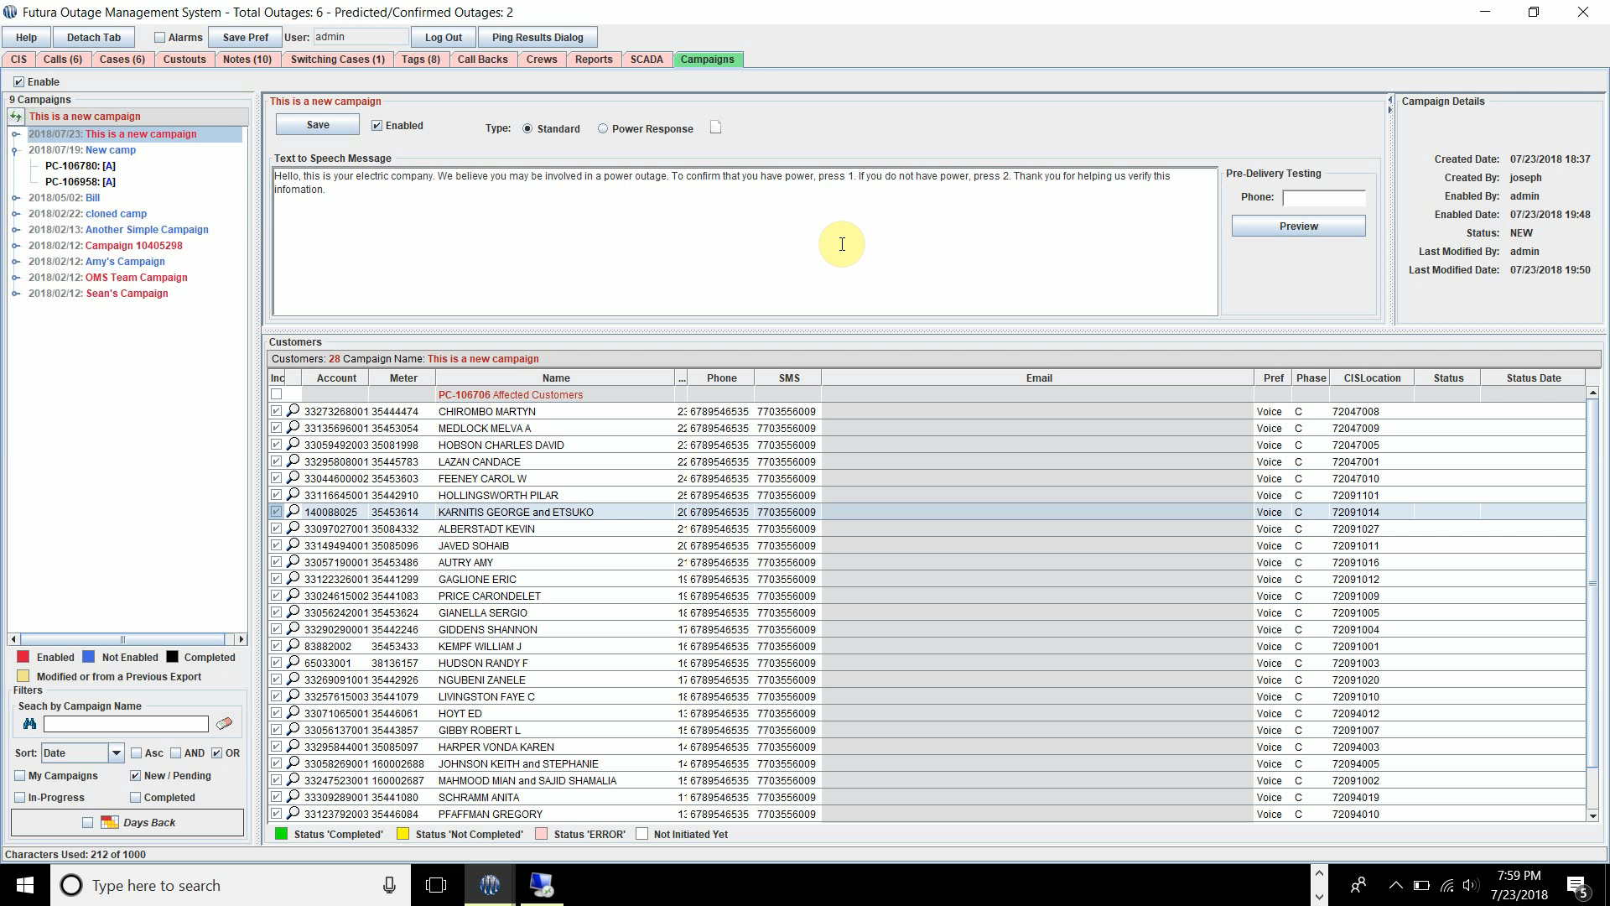
Campaigns – Manual Call
Notes:
Now I want to show you all the campaigns tab in OMS
This is one of our newest features that can be used to create a list of callback responses and have the software automatically reach out to those consumers. The automatic functionality highly depends on your IV vendor if they support this feature.
Campaigns can also be exported and shared across dispatch teams to follow up with consumers in the event an IVR system is NOT in place.

Slide 21
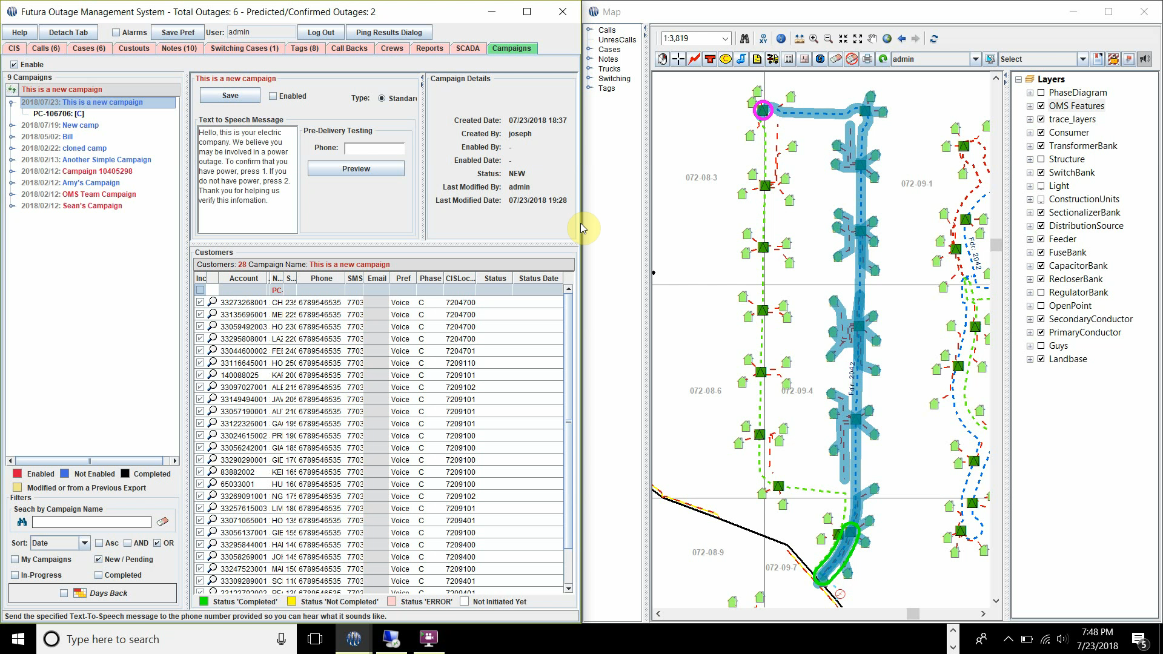
Campaigns – Testing
Notes:
Now I want to show you all the campaigns tab in OMS
This is one of our newest features that can be used to create a list of callback responses and have the software automatically reach out to those consumers. The automatic functionality highly depends on your IV vendor if they support this feature.
Campaigns can also be exported and shared across dispatch teams to follow up with consumers in the event an IVR system is NOT in place.

Slide 22
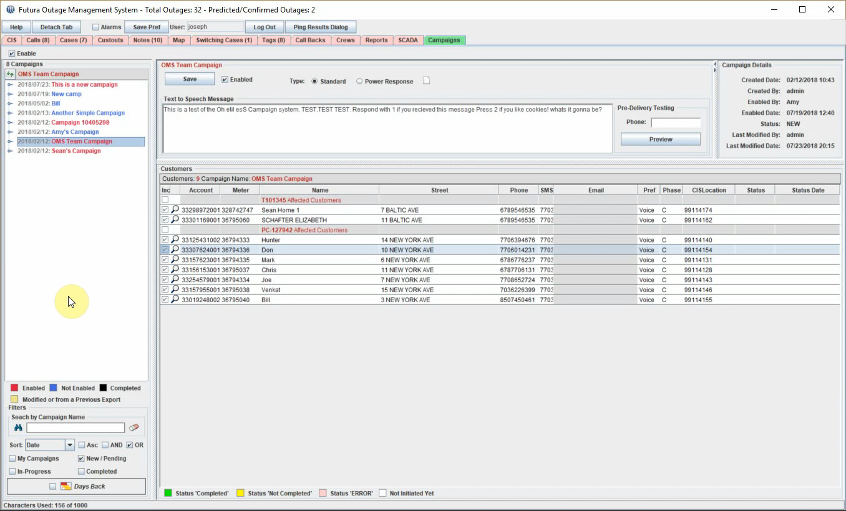
Campaigns – Initiate
Notes:
Now I want to show you all the campaigns tab in OMS
This is one of our newest features that can be used to create a list of callback responses and have the software automatically reach out to those consumers. The automatic functionality highly depends on your IV vendor if they support this feature.
Campaigns can also be exported and shared across dispatch teams to follow up with consumers in the event an IVR system is NOT in place.

Slide 23
Questions?

